Slide 1
DB Visualizer
Vikas Adiwal
17201

Slide 2
DB Visualizer:
Problem Statement:
Recreate the functionality of Explain() found in PGADMIN for MongoDB

Slide 3
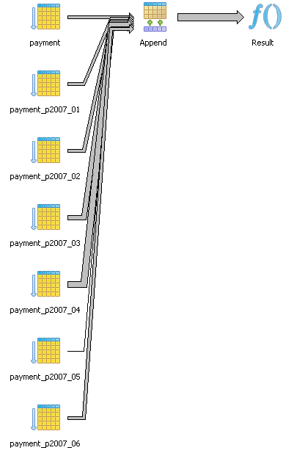
A Sample Explain Result in PGADMIN
Result (cost=0.00..420.63 rows=54 width=31) (actual time=0.262..5.193 rows=37 loops=1) -> Append (cost=0.00..420.63 rows=54 width=31) (actual time=0.261..5.173 rows=37 loops=1) -> Seq Scan on payment (cost=0.00..29.95 rows=7 width=31) (actual time=0.001..0.001 rows=0 loops=1) Filter: ((payment_date >= '2007-02-01 00:00:00'::timestamp without time zone) AND (payment_date <= '2007-02-15 00:00:00'::timestamp without time zone)) -> Seq Scan on payment_p2007_01 payment (cost=0.00..26.36 rows=1 width=28) (actual time=0.244..0.244 rows=0 loops=1) Filter: ((payment_date >= '2007-02-01 00:00:00'::timestamp without time zone) AND (payment_date <= '2007-02-15 00:00:00'::timestamp without time zone))

Slide 4
Structure of result returned by explain in MongoDB
{
"queryPlanner" : {
"plannerVersion" : <int>,
"namespace" : <string>,
"indexFilterSet" : <boolean>,
"parsedQuery" : {
...
},
"winningPlan" : {
"stage" : <STAGE1>,
...
"inputStage" : {
"stage" : <STAGE2>,
...
"inputStage" : {
...
}
}
},
"rejectedPlans" : [
<candidate plan 1>,
...
]
}
"executionStats" : {
"executionSuccess" : <boolean>,
"nReturned" : <int>,
"executionTimeMillis" : <int>,
"totalKeysExamined" : <int>,
"totalDocsExamined" : <int>,
"executionStages" : {
"stage" : <STAGE1>
"nReturned" : <int>,
"executionTimeMillisEstimate" : <int>,
"works" : <int>,
"advanced" : <int>,
"needTime" : <int>,
"needYield" : <int>,
"saveState" : <int>,
"restoreState" : <int>,
"isEOF" : <boolean>,
...
"inputStage" : {
"stage" : <STAGE2>,
...
"nReturned" : <int>,
"executionTimeMillisEstimate" : <int>,
"keysExamined" : <int>,
"docsExamined" : <int>,
"saveState" : <int>,
"restoreState" : <int>,
...
}
},
"allPlansExecution" : [
{ <partial executionStats1> },
{ <partial executionStats2> },
...
]
}
"serverInfo" : {
"host" : <string>,
"port" : <int>,
"version" : <string>,
"gitVersion" : <string>
}

Slide 5
mongoDB explain() Explained...

Slide 6
Explain Results
The explain results present the query plans as a tree of stages. Each stage passes its results (i.e. documents or index keys) to the parent node. The leaf nodes access the collection or the indices. The internal nodes manipulate the documents or the index keys that result from the child nodes. The root node is the final stage from which MongoDB derives the result set.
Major Fields returned by explain:
Query Planner
Execution Stats
Server Info
Stages are descriptive of the operation eg:
COLLSCAN for a collection scan
IXSCAN for scanning index keys
FETCH for retrieving documents

Slide 7
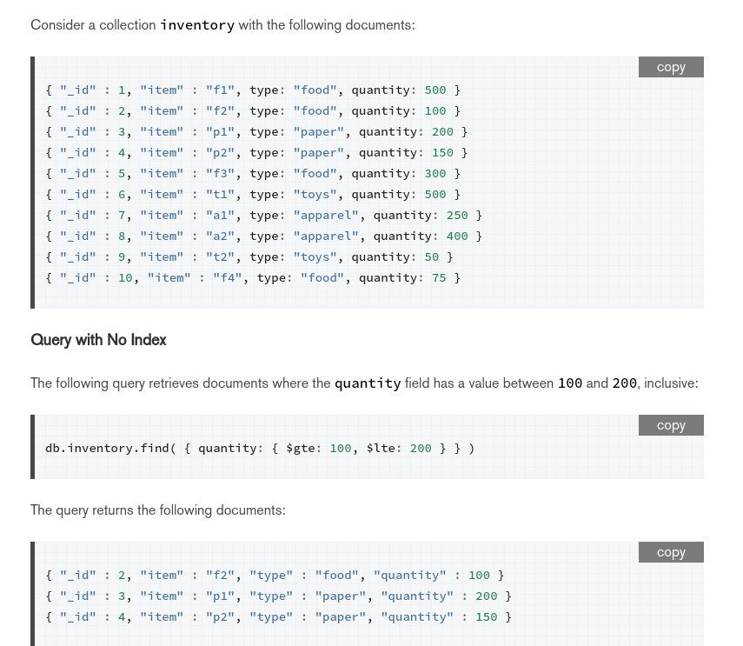

Slide 9
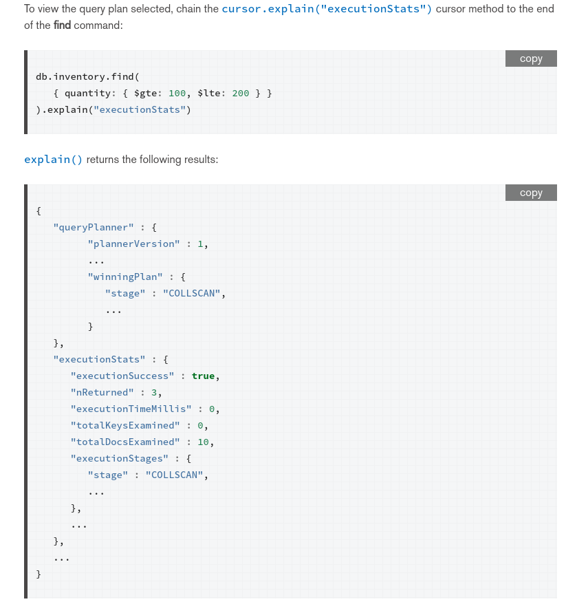

Slide 11
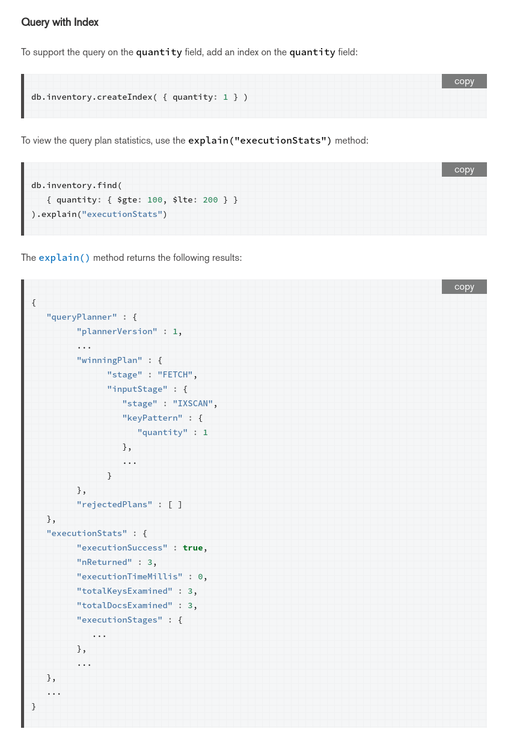

Slide 13

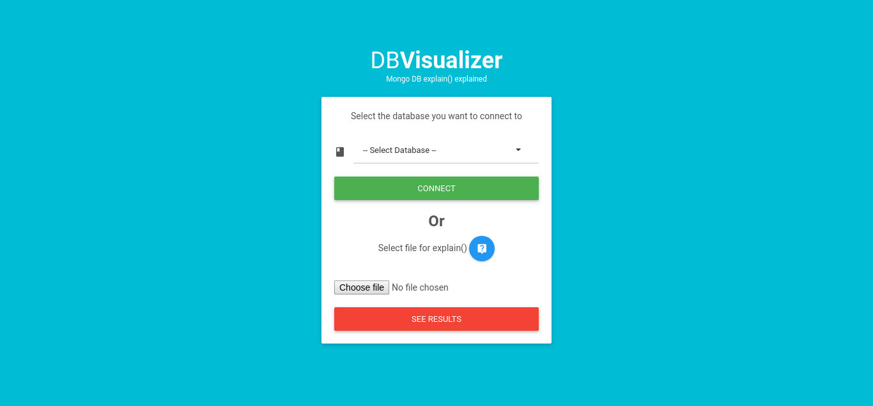
Demonstration Time

Slide 14
THANKS!

